Slide 1
October 25th, 2022
Central Dakota Amateur Radio Club
PO Box 7162 Bismarck, North Dakota 58507-7162
Monthly Club Meeting

Slide 2
Central Dakota Amateur Radio Club
PO Box 7162 Bismarck, North Dakota 58507-7162
October 25th, 2022, MEETING AGENDA
A. Approval of September 2022 meeting minutes.
B. Treasurer's Report
Guests.
COMMITTEE REPORTS:
Technical.
Skywarn
VE Testing
Net Control report
OLD BUSINESS:
Projects at BSC planning
Dipole antenna class October 29th
Girl Scout Big Event Report
Jamboree on the Air Report
HAMFEST 2023 Planning
NEW BUSINESS:
Missouri Slope Model Aero Club donation.
Elections
Christmas Party
Lewis and Clark on the Trail June 3rd –18th 23
New Equipment
Tower Site Recognition / Appreciation
50/50
Announcements
ADJOURN

Slide 3
Central Dakota Amateur Radio Club
PO Box 7162 Bismarck, North Dakota 58507-7162
October 25th, 2022, MEETING AGENDA
A. Approval of September 2022 meeting minutes.
B. Treasurer's Report
Guests.
COMMITTEE REPORTS:
Technical.
Skywarn
VE Testing
Net Control report
OLD BUSINESS:
Projects at BSC planning
Dipole antenna class October 29th
Girl Scout Big Event Report
Jamboree on the Air Report
HAMFEST 2023 Planning
NEW BUSINESS:
Missouri Slope Model Aero Club donation.
Elections
Christmas Party
Lewis and Clark on the Trail June 3rd –18th 23
New Equipment
Tower Site Recognition / Appreciation
50/50
Announcements
ADJOURN

Slide 4
Central Dakota Amateur Radio Club
PO Box 7162 Bismarck, North Dakota 58507-7162
October 25th, 2022, MEETING AGENDA
A. Approval of September 2022 meeting minutes.
B. Treasurer's Report
Guests.
COMMITTEE REPORTS:
Technical.
Skywarn
VE Testing
Net Control report
OLD BUSINESS:
Projects at BSC planning
Dipole antenna class October 29th
Girl Scout Big Event Report
Jamboree on the Air Report
HAMFEST 2023 Planning
NEW BUSINESS:
Missouri Slope Model Aero Club donation.
Elections
Christmas Party
Lewis and Clark on the Trail June 3rd –18th 23
New Equipment
Tower Site Recognition / Appreciation
50/50
Announcements
ADJOURN

Slide 5
Central Dakota Amateur Radio Club
PO Box 7162 Bismarck, North Dakota 58507-7162
October 25th, 2022, MEETING AGENDA
A. Approval of September 2022 meeting minutes.
B. Treasurer's Report
Guests.
COMMITTEE REPORTS:
Technical.
Skywarn
VE Testing
Net Control report
OLD BUSINESS:
Projects at BSC planning
Dipole antenna class October 29th
Girl Scout Big Event Report
Jamboree on the Air Report
HAMFEST 2023 Planning
NEW BUSINESS:
Missouri Slope Model Aero Club donation.
Elections
Christmas Party
Lewis and Clark on the Trail June 3rd –18th 23
New Equipment
Tower Site Recognition / Appreciation
50/50
Announcements
ADJOURN

Slide 6
TECHNICAL COMMITTEE REPORT
MARK / N0FAZ
RANDY / KC0CAU
PETE / KF0DL

Slide 7
Technical Report and Updates
Hanover Repeater Duplexer Replacement
Make & Model | Freq. Range | Type | Insertion Loss | Min. Freq. Sep. | Isolation | Power Rating | Price
Telewave - Duplexer TPRD-1554 | 144-174 MHz | Pass/ Reject | 1.5dB | 600KHz | 77dB | 350w | 2,689.00
Telewave Compact TPRD-1444C | 135-151 MHz | Pass/ Reject | 1.5dB | 600KHz | 70dB | 350w | 2,607.42
SINCLAIR's Q2220E | 132 – 174 MHz | Pass/ Reject | 1.5dB | 500KHz | 70dB | 350w | 2,165.00
COMPROD 66-13-74 | 138 – 174 MHz | Pass/ Reject | 1.5dB | 500HKz | 85dB | 400w | 2,301.00

Slide 8
Central Dakota Amateur Radio Club
PO Box 7162 Bismarck, North Dakota 58507-7162
October 25th, 2022, MEETING AGENDA
A. Approval of September 2022 meeting minutes.
B. Treasurer's Report
Guests.
COMMITTEE REPORTS:
Technical.
Skywarn
VE Testing
Net Control report
OLD BUSINESS:
Projects at BSC planning
Dipole antenna class October 29th
Girl Scout Big Event Report
Jamboree on the Air Report
HAMFEST 2023 Planning
NEW BUSINESS:
Missouri Slope Model Aero Club donation.
Elections
Christmas Party
Lewis and Clark on the Trail June 3rd –18th 23
New Equipment
Tower Site Recognition / Appreciation
50/50
Announcements
ADJOURN

Slide 9
SKYWARN REPORT
NO REPORT

Slide 10
Central Dakota Amateur Radio Club
PO Box 7162 Bismarck, North Dakota 58507-7162
October 25th, 2022, MEETING AGENDA
A. Approval of September 2022 meeting minutes.
B. Treasurer's Report
Guests.
COMMITTEE REPORTS:
Technical.
Skywarn
VE Testing
Net Control report
OLD BUSINESS:
Projects at BSC planning
Dipole antenna class October 29th
Girl Scout Big Event Report
Jamboree on the Air Report
HAMFEST 2023 Planning
NEW BUSINESS:
Missouri Slope Model Aero Club donation.
Elections
Christmas Party
Lewis and Clark on the Trail June 3rd –18th 23
New Equipment
Tower Site Recognition / Appreciation
50/50
Announcements
ADJOURN

Slide 11
VE TESTING REPORT
BOB / N0TC

Slide 12
Central Dakota Amateur Radio Club
PO Box 7162 Bismarck, North Dakota 58507-7162
October 25th, 2022, MEETING AGENDA
A. Approval of September 2022 meeting minutes.
B. Treasurer's Report
Guests.
COMMITTEE REPORTS:
Technical.
Skywarn
VE Testing
Net Control report
OLD BUSINESS:
Projects at BSC planning
Dipole antenna class October 29th
Girl Scout Big Event Report
Jamboree on the Air Report
HAMFEST 2023 Planning
NEW BUSINESS:
Missouri Slope Model Aero Club donation.
Elections
Christmas Party
Lewis and Clark on the Trail June 3rd –18th 23
New Equipment
Tower Site Recognition / Appreciation
50/50
Announcements
ADJOURN

Slide 13
NET CONTROL REPORT
LORNE /N0CYK New Net Control Coordinator

Slide 14
Net Control August report
Sunday, August 7, 2022 |  |  |  |  | NR |  | NR |  | NR
Sunday, August 14, 2022 |  |  |  |  | 7 |  | 3 |  | 0
Sunday, August 21, 2022 |  |  |  |  | NR |  | NR |  | NR
Sunday, August 28, 2022 |  |  |  |  | 12 |  | 3 |  | 3
 |  | # of nets |  |  | 2m vhf checkins |  | 2m SSB checkins |  | 6M SSB checkins
 |  | 2 |  |  | 19 |  | 6 |  | 3
 |  |  |  |  | 2 |  | 2 |  | 2

Slide 15
Net Control September report
Sunday, September 4, 2022 |  |  |  |  | No net |  | Holiday
Sunday, September 11, 2022 |  |  |  |  | NR |  | NR |  | NR
Sunday, September 18, 2022 |  |  |  |  | 10 |  | 3 |  | 0
Sunday, September 25, 2022 |  |  |  |  | 12 |  | 4 |  | 0
 |  | # of nets |  |  | 2m vhf checkins |  | 2m SSB checkins |  | 6M SSB checkins
 |  | 2 |  |  | 22 |  | 7 |  | 0
 |  |  |  |  | 2 |  | 2 |  | 2

Slide 16
Net Control October report
Sunday, October 2, 2022 |  |  |  | NR |  | NR |  | NR
Sunday, October, 9, 2022 |  |  |  | 11 |  | 4 |  | 2
Sunday, October 16, 2022 |  |  |  | NR |  | NR |  | NR
Sunday, October 23, 2022 |  |  |  | 9 |  | 5 |  | 4
Sunday, October 30, 2022
 |  | # of nets |  | 2m vhf checkins |  | 2m SSB checkins |  | 6M SSB checkins
 |  | 2 |  | 20 |  | 9 |  | 6

Slide 17
Central Dakota Amateur Radio Club
PO Box 7162 Bismarck, North Dakota 58507-7162
October 25th, 2022, MEETING AGENDA
A. Approval of September 2022 meeting minutes.
B. Treasurer's Report
Guests.
COMMITTEE REPORTS:
Technical.
Skywarn
VE Testing
Net Control report
OLD BUSINESS:
Projects at BSC planning
Dipole antenna class October 29th
Girl Scout Big Event Report
Jamboree on the Air Report
HAMFEST 2023 Planning
NEW BUSINESS:
Missouri Slope Model Aero Club donation.
Elections
Christmas Party
Lewis and Clark on the Trail June 3rd –18th 23
New Equipment
Tower Site Recognition / Appreciation
50/50
Announcements
ADJOURN

Slide 18
Dipole Workshop plan
Discuss how a dipole antenna works
Discuss the gain of a dipole antenna
Discuss the math for calculating the proper length of each element

Slide 19
Central Dakota Amateur Radio Club
PO Box 7162 Bismarck, North Dakota 58507-7162
October 25th, 2022, MEETING AGENDA
A. Approval of September 2022 meeting minutes.
B. Treasurer's Report
Guests.
COMMITTEE REPORTS:
Technical.
Skywarn
VE Testing
Net Control report
OLD BUSINESS:
Projects at BSC planning
Dipole antenna class October 29th
Girl Scout Big Event Report
Jamboree on the Air Report
HAMFEST 2023 Planning
NEW BUSINESS:
Missouri Slope Model Aero Club donation.
Elections
Christmas Party
Lewis and Clark on the Trail June 3rd –18th 23
New Equipment
Tower Site Recognition / Appreciation
50/50
Announcements
ADJOURN
20.00

Slide 20
Central Dakota Amateur Radio Club
W0ZRT
Activating Club
Activating State
Activating Call
Central Dakota Amateur Radio Club
North Dakota
W0ZRT
Operator Name
Control Operator Name & Call Sign
Call
Date
UTC
MHz
Mode
RST
10/1/2022

Slide 21
Central Dakota Amateur Radio Club
W0ZRT
Activating Club
Activating State
Activating Call
Central Dakota Amateur Radio Club
North Dakota
W0ZRT
Number of Kids Participating
85 + 45 parents
Control Operators Name & Call Sign
Mike/KE0ESG, Chad/KC0AFB, Lorne/N0CYK Bob/N0TC,Randy/KC0CAU,Bruce/
Call
Date
UTC
MHz
Mode
RST
10/1/2022

Slide 22
Made contact with 19 states and two countries (Germany and Scotland)

Slide 23
Central Dakota Amateur Radio Club
PO Box 7162 Bismarck, North Dakota 58507-7162
October 25th, 2022, MEETING AGENDA
A. Approval of September 2022 meeting minutes.
B. Treasurer's Report
Guests.
COMMITTEE REPORTS:
Technical.
Skywarn
VE Testing
Net Control report
OLD BUSINESS:
Projects at BSC planning
Dipole antenna class October 29th
Girl Scout Big Event Report
Jamboree on the Air Report
HAMFEST 2023 Planning
NEW BUSINESS:
Missouri Slope Model Aero Club donation.
Elections
Christmas Party
Lewis and Clark on the Trail June 3rd –18th 23
New Equipment
Tower Site Recognition / Appreciation
50/50
Announcements
ADJOURN

Slide 24
Jamboree On The Air
W0ZRT
Activating Club
Activating State
Activating Call
Central Dakota Amateur Radio Club
North Dakota
WA0BSA
Call
Date
UTC
MHz
Mode
RST
Sponsored by the Central Dakota Amateur Radio Club www.cdarcnd.com

Slide 25
Jamboree On The Air
W0ZRT
Activating Club
Activating State
Activating Call
Central Dakota Amateur Radio Club
North Dakota
WA0BSA
Call
Date
UTC
MHz
Mode
RST
Sponsored by the Central Dakota Amateur Radio Club www.cdarcnd.com

Slide 26
Made contact with 19 states and two countries (Japan and Mexico)

Slide 28
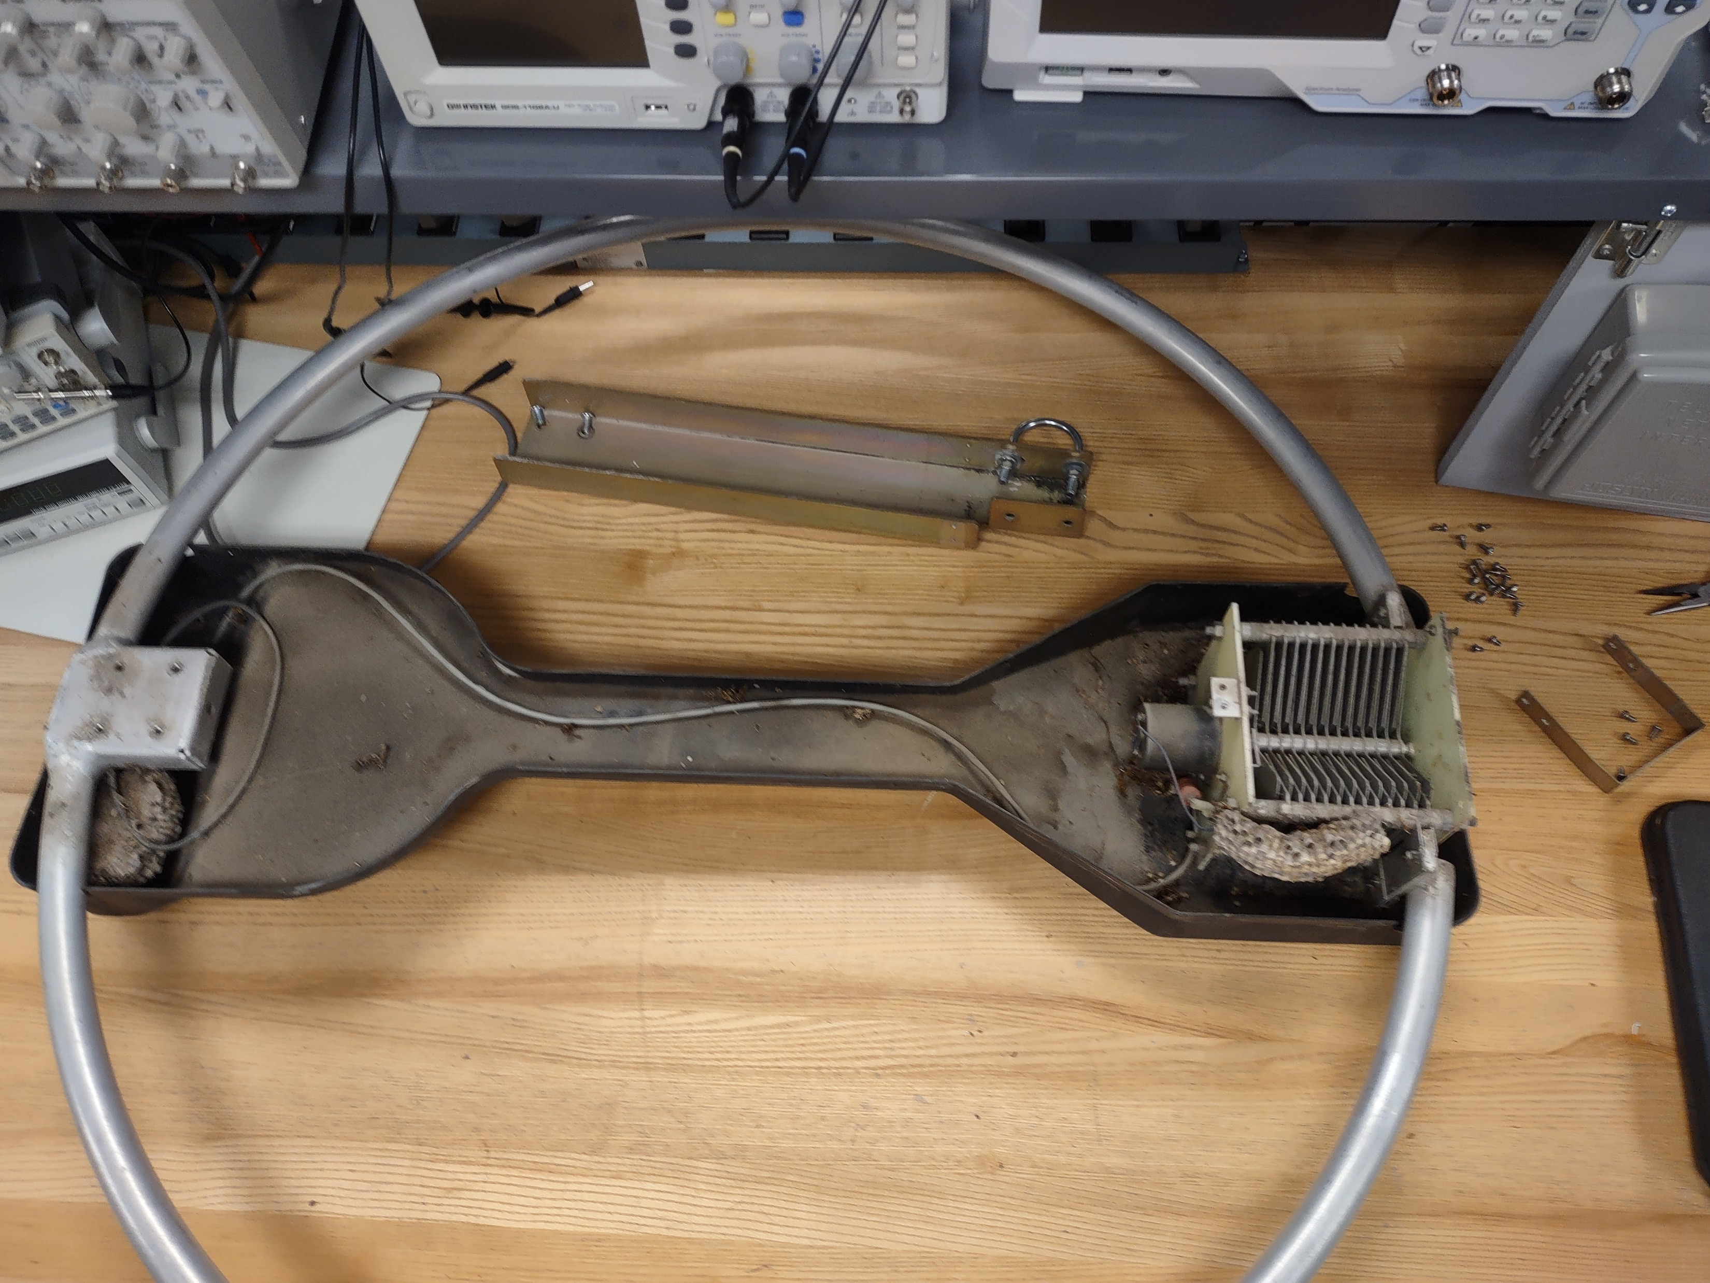

Slide 29
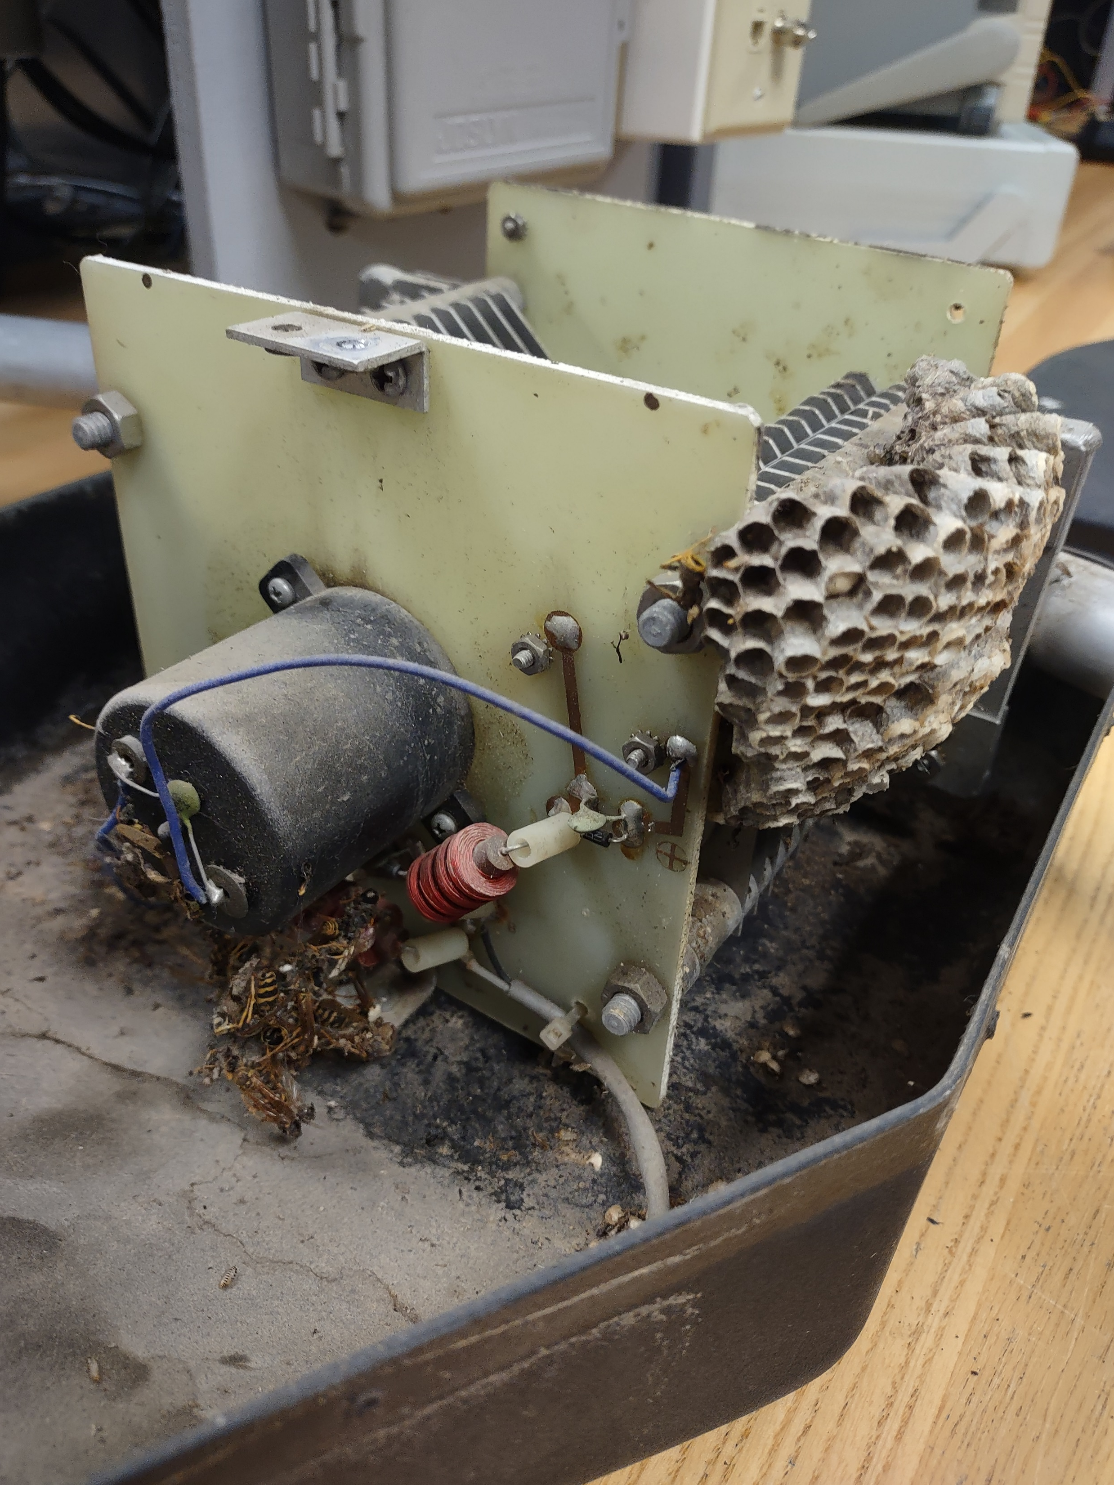
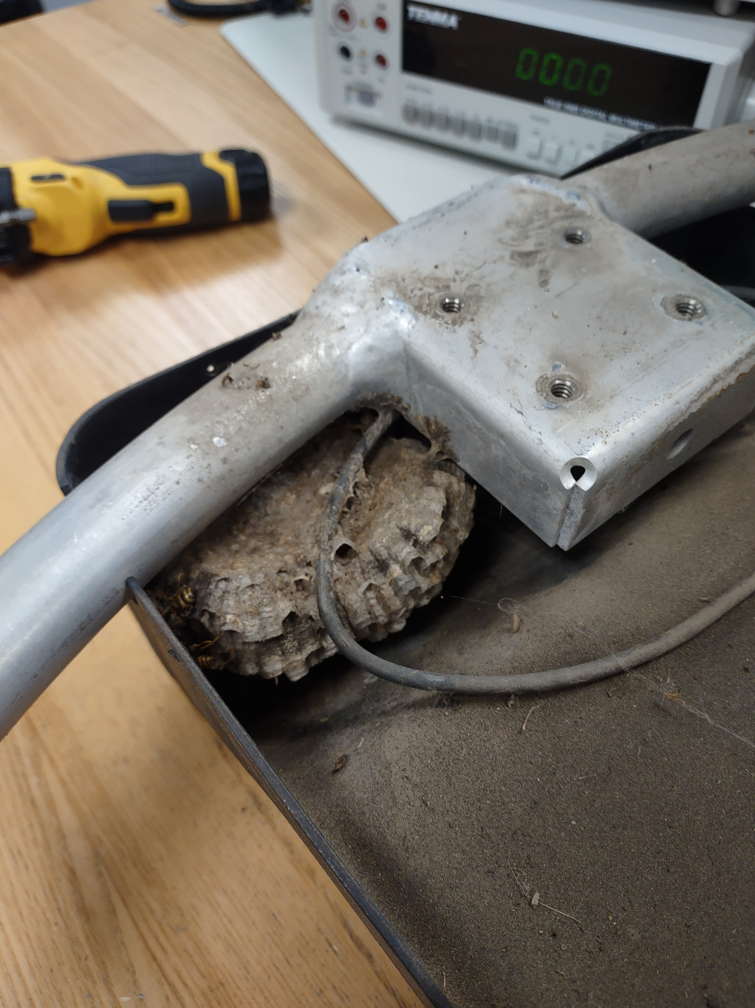

Slide 30
Central Dakota Amateur Radio Club
PO Box 7162 Bismarck, North Dakota 58507-7162
October 25th, 2022, MEETING AGENDA
A. Approval of September 2022 meeting minutes.
B. Treasurer's Report
Guests.
COMMITTEE REPORTS:
Technical.
Skywarn
VE Testing
Net Control report
OLD BUSINESS:
Projects at BSC planning
Dipole antenna class October 29th
Girl Scout Big Event Report
Jamboree on the Air Report
HAMFEST 2023 Planning
NEW BUSINESS:
Missouri Slope Model Aero Club donation.
Elections
Christmas Party
Lewis and Clark on the Trail June 3rd –18th 23
New Equipment
Tower Site Recognition / Appreciation
50/50
Announcements
ADJOURN

Slide 31
CDARC Annual Hamfest Checklist
DATE | TASK | ASSIGNED TO | COMPLETED
September 27, 2022 | Appoint Hamfest Committee Chair: | LORNE/N0CYK | completed
 | Co-chair: | Mike/ KE0ESG
October 25, 2022 | Locate hamfest materials container | DEE/WB0CGK, CHAD/KC0AFB
November 1, 2022 | Prepare and send notification to ARRL (on line link: http://www.arrl.org/hamfest-convention-application ) | LORNE/N0CYK
November 22, 2022 | Determine the prizes to be awarded at the Hamfest, and who is responsible for obtaining the prizes.
December 1, 2022 | Prepare Hamfest flyer | MIKE/KE0ESG | Draft Completed
December 1, 2022 | Notify Dakota Division Director, Vice Director & Section Manager of hamfest date and location. | LORNE/N0CYK
December 1, 2022 | Confirm with Bismarck State College that CDARC has access Friday evening prior to the hamfest, and the day of the hamfest. | MIKE/KE0ESG
December 1, 2022 | Solicit briefings, presentations, etc., for hamfest schedule | LORNE/N0CYK

Slide 32
DATE | TASK | ASSIGNED TO | COMPLETED
January 3, 2023 | Complete & distribute hamfest flyers | MIKE/KE0ESG
January 3, 2023 | Confirm hamfest food preparation operations | Mark/Rick
January 3, 2023 | Confirm registration staff operations | DEE/WB0CGK
January 17, 2023 | Obtain City raffle permit | DEE/WB0CGK
January 3, 2023 | Order annual hamfest buttons
January 3, 2023 | Advertise hamfest in local newspaper and media | LORNE/N0CYK
January 3, 2023 | Obtain keys to Bismarck State College | MIKE/KE0ESG
January 25, 2022 | Contact venue for Friday night dinner (North Pizza Ranch) | justin/k0jbm
February 24, 2023 | advanced setup at 7pm Friday night | MIKE/KE0ESG
February 24, 2023 | Install VHF radio, coax & antenna
February 24, 2023 | Place signs in hallway & Multipurpose Room
February 24, 2023 | Set up BSC Multipurpose room sound system | MIKE/KE0ESG
February 24, 2023 | Set up tables & table assignments | BSC STAFF, LORNE/N0CYK
February 24, 2023 | Coordinate with kitchen crew concerning access on Saturday morning

Slide 33
DATE | TASK | ASSIGNED TO | COMPLETED
February 25, 2023 | Ensure prizes are on site.
February 25, 2023 | 50/50 bucket | MIKE/KE0ESG
February 25, 2023 | Teardown: put away tables & chairs and sweep gym. Ensure trash is removed. | CLUB MEMBERS
March 28, 2023 | Send thank-you letter to school and vendors providing prizes. | MIKE/KE0ESG & Lorne/N0CYK

Slide 34
Central Dakota Amateur Radio Club
PO Box 7162 Bismarck, North Dakota 58507-7162
October 25th, 2022, MEETING AGENDA
A. Approval of September 2022 meeting minutes.
B. Treasurer's Report
Guests.
COMMITTEE REPORTS:
Technical.
Skywarn
VE Testing
Net Control report
OLD BUSINESS:
Projects at BSC planning
Dipole antenna class October 29th
Girl Scout Big Event Report
Jamboree on the Air Report
HAMFEST 2023 Planning
NEW BUSINESS:
Missouri Slope Model Aero Club donation.
Elections
Christmas Party
Lewis and Clark on the Trail June 3rd –18th 23
New Equipment
Tower Site Recognition / Appreciation
50/50
Announcements
ADJOURN

Slide 35
Central Dakota Amateur Radio Club
PO Box 7162 Bismarck, North Dakota 58507-7162
October 25th, 2022, MEETING AGENDA
A. Approval of September 2022 meeting minutes.
B. Treasurer's Report
Guests.
COMMITTEE REPORTS:
Technical.
Skywarn
VE Testing
Net Control report
OLD BUSINESS:
Projects at BSC planning
Dipole antenna class October 29th
Girl Scout Big Event Report
Jamboree on the Air Report
HAMFEST 2023 Planning
NEW BUSINESS:
Missouri Slope Model Aero Club donation.
Elections
Christmas Party
Lewis and Clark on the Trail June 3rd –18th 23
New Equipment
Tower Site Recognition / Appreciation
50/50
Announcements
ADJOURN

Slide 36
Elections Planning
Elections will be held in March with elected officers taking office at end of meeting in March
Normal Meeting in November
No meeting in December
Hamfest in February
Election in March
In the past the Secretary has been the Election Chair. If the Secretary is running for an office, we need to select an Election chair.

Slide 37
SUBJECT: 2023 Central Dakota Amateur Radio Club Elections
1. The 2023 election for CDARC officers will take place at the March 28th, 2023 meeting. If you want to run for any of the following offices, please contact me no later than March 14th, 2023:
- President
- Vice President
- Secretary
- Treasurer
- Member at Large (2 positions)
2. In order to run for office, you must be a member in good standing of the CDARC; that means your CDARC dues must be current. In order to vote in the election, you must also be a member in good standing. Please be advised that all offices are now two-year terms.
3. The list of members in good standing who wish to run for office will be published after the March 9th Executive Board Meeting so that the candidates will be known to the general membership prior to the March 28th election. If you do not get the notification, please contact me at the email address below and I will send you the information.

Slide 38
SUBJECT: 2023 Central Dakota Amateur Radio Club Elections
4. Please be advised that nominations will also be taken from the floor at the March 28th meeting, in accordance with the CDARC by-laws.
5. The election will be conducted by secret ballot. The ballot will contain the names of those members in good standing who have contacted me and indicated their desire to run for a particular office. The ballot will also contain space for “write in” candidates; this space may be used for any member in good standing who is nominated from the floor at the March 23rd meeting. Ballots will be given to members in good standing at the March 28th meeting and the vote will be conducted at the meeting. Ballots will be counted by no less than three members (myself and two members not running for office).
6. I will not be contacting individuals or incumbents to determine if they do or do not want to run for office. You must contact me in order to get on the ballot. Please email your wishes to me at ______________ or provide them in writing so there is a written record. I will reply to your email acknowledging receipt; if you do not get a reply you should contact me at _______________________
7. If you have any questions concerning the election, please contact me.
______________________
CDARC Secretary/Election Chairman

Slide 39
Central Dakota Amateur Radio Club
PO Box 7162 Bismarck, North Dakota 58507-7162
October 25th, 2022, MEETING AGENDA
A. Approval of September 2022 meeting minutes.
B. Treasurer's Report
Guests.
COMMITTEE REPORTS:
Technical.
Skywarn
VE Testing
Net Control report
OLD BUSINESS:
Projects at BSC planning
Dipole antenna class October 29th
Girl Scout Big Event Report
Jamboree on the Air Report
HAMFEST 2023 Planning
NEW BUSINESS:
Missouri Slope Model Aero Club donation.
Elections
Christmas Party
Lewis and Clark on the Trail June 3rd –18th 23
New Equipment
Tower Site Recognition / Appreciation
50/50
Announcements
ADJOURN

Slide 40
Central Dakota Amateur Radio Club
PO Box 7162 Bismarck, North Dakota 58507-7162
October 25th, 2022, MEETING AGENDA
A. Approval of September 2022 meeting minutes.
B. Treasurer's Report
Guests.
COMMITTEE REPORTS:
Technical.
Skywarn
VE Testing
Net Control report
OLD BUSINESS:
Projects at BSC planning
Dipole antenna class October 29th
Girl Scout Big Event Report
Jamboree on the Air Report
HAMFEST 2023 Planning
NEW BUSINESS:
Missouri Slope Model Aero Club donation.
Elections
Christmas Party
Lewis and Clark on the Trail June 3rd –18th 23
New Equipment
Tower Site Recognition / Appreciation
50/50
Announcements
ADJOURN

Slide 41
Central Dakota Amateur Radio Club
PO Box 7162 Bismarck, North Dakota 58507-7162
October 25th, 2022, MEETING AGENDA
A. Approval of September 2022 meeting minutes.
B. Treasurer's Report
Guests.
COMMITTEE REPORTS:
Technical.
Skywarn
VE Testing
Net Control report
OLD BUSINESS:
Projects at BSC planning
Dipole antenna class October 29th
Girl Scout Big Event Report
Jamboree on the Air Report
HAMFEST 2023 Planning
NEW BUSINESS:
Missouri Slope Model Aero Club donation.
Elections
Christmas Party
Lewis and Clark on the Trail June 3rd –18th 23
New Equipment
Tower Site Recognition / Appreciation
50/50
Announcements
ADJOURN

Slide 42
Central Dakota Amateur Radio Club
PO Box 7162 Bismarck, North Dakota 58507-7162
October 25th, 2022, MEETING AGENDA
A. Approval of September 2022 meeting minutes.
B. Treasurer's Report
Guests.
COMMITTEE REPORTS:
Technical.
Skywarn
VE Testing
Net Control report
OLD BUSINESS:
Projects at BSC planning
Dipole antenna class October 29th
Girl Scout Big Event Report
Jamboree on the Air Report
HAMFEST 2023 Planning
NEW BUSINESS:
Missouri Slope Model Aero Club donation.
Elections
Christmas Party
Lewis and Clark on the Trail June 3rd –18th 23
New Equipment
Tower Site Recognition / Appreciation
50/50
Announcements
ADJOURN

Slide 43
Central Dakota Amateur Radio Club
PO Box 7162 Bismarck, North Dakota 58507-7162
October 25th, 2022, MEETING AGENDA
A. Approval of September 2022 meeting minutes.
B. Treasurer's Report
Guests.
COMMITTEE REPORTS:
Technical.
Skywarn
VE Testing
Net Control report
OLD BUSINESS:
Projects at BSC planning
Dipole antenna class October 29th
Girl Scout Big Event Report
Jamboree on the Air Report
HAMFEST 2023 Planning
NEW BUSINESS:
Missouri Slope Model Aero Club donation.
Elections
Christmas Party
Lewis and Clark on the Trail June 3rd –18th 23
New Equipment
Tower Site Recognition / Appreciation
50/50
Announcements
ADJOURN

Slide 44
Central Dakota Amateur Radio Club
PO Box 7162 Bismarck, North Dakota 58507-7162
October 25th, 2022, MEETING AGENDA
A. Approval of September 2022 meeting minutes.
B. Treasurer's Report
Guests.
COMMITTEE REPORTS:
Technical.
Skywarn
VE Testing
Net Control report
OLD BUSINESS:
Projects at BSC planning
Dipole antenna class October 29th
Girl Scout Big Event Report
Jamboree on the Air Report
HAMFEST 2023 Planning
NEW BUSINESS:
Missouri Slope Model Aero Club donation.
Elections
Christmas Party
Lewis and Clark on the Trail June 3rd –18th 23
New Equipment
Tower Site Recognition / Appreciation
50/50
Announcements
ADJOURN

Slide 45
Central Dakota Amateur Radio Club
PO Box 7162 Bismarck, North Dakota 58507-7162
October 25th, 2022, MEETING AGENDA
A. Approval of September 2022 meeting minutes.
B. Treasurer's Report
Guests.
COMMITTEE REPORTS:
Technical.
Skywarn
VE Testing
Net Control report
OLD BUSINESS:
Projects at BSC planning
Dipole antenna class October 29th
Girl Scout Big Event Report
Jamboree on the Air Report
HAMFEST 2023 Planning
NEW BUSINESS:
Missouri Slope Model Aero Club donation.
Elections
Christmas Party
Lewis and Clark on the Trail June 3rd –18th 23
New Equipment
Tower Site Recognition / Appreciation
Educational materials for youth organizations
Update on the gateway to science
50/50
Announcements
ADJOURN

Slide 46
Announcements
November 2022 Club Meeting and License Testing
October 25th, 2022, Testing 6:00pm, Meeting 7:00pm Bismarck State College Career Academy, Rm 230 1221 College Dr. Bismarck ND
CDARC Executive Committee meeting:
November 8th, 2022, 7:00 pm
Scheel’s cafeteria, Bismarck ND.
November 2022 CDARC Monthly Meeting:
November 29th, 2022, Testing 6:00pm, Meeting 7:00pm Bismarck State College Career Academy, Rm 230 1221 College Dr. Bismarck ND
MEETING MINUTES FORM
MEETING CALLED TO ORDER AT ______________
Approval of September 2022 meeting minutes.
MOTION TO APPROVE _____________ SECONDED BY __________________
MOTION PASS FAIL (circle one)
Treasurer’s Report
MOTION TO APPROVE _____________ SECONDED BY __________________
MOTION PASS FAIL (circle one)

Slide 48
Workshops for Fall
Dipole antenna design and build.
You pick the band, help provided for build.
Fan Dipole possible?
Digital Mode Demonstration and Configurations
FT-8
WIRES-X
FUSSION

